Slide 1
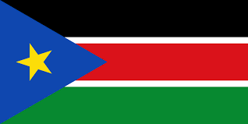
South Sudan
By Ronan Malone

Slide 2
topics
Independence from Sudan
Taller than average people
South Sudanese civil war
Capital City
Fun Facts

Slide 3
independence from Sudan
On the 9th of July 2011 South Sudan became a new country. Before they got independence from Sudan it was the biggest country in Africa. On their independence day there is always a massive celebration.(9th of July). They had the longest running civil war in African. Later in this project I will tell you about it.

Slide 4
Taller than average
In some tribes in South Sudan the average height for a male is 6 foot 4 inches and a female is 6 foot. In Ireland the average male height is 5 foot 10 inches and a female 5 foot 5 inches. In basketball their rims are 12 feet instead of 10 feet. In some Dinka males can grow taller 7 foot.

Slide 5
South Sudanese civil war
The South Sudanese civil war started the 14th of December 2013 and ended on the 22nd of February 2020. The South Sudanese civil war was a conflict in South Sudan between forces of the government and opposite forces. Two million people fled the country because of the civil war.

Slide 6
Capital city
Juba is the capital city of South Sudan. It is the biggest city in South Sudan with a population of 492,970. The size of Juba is 52 Km²
The national language is English since that it only became an official country recently.
Juba has a big police and army force because of the civil war.

Slide 7
Fun facts
During the civil war nearly 2.3 million people left the country.
The population of South Sudan is 12 million.
South Sudan has reported it’s first case of Covid 19 on Friday March 13th

Slide 8
The end
This is all of my project thanks for tuning in stay safe and goodbye!

