Slide 1
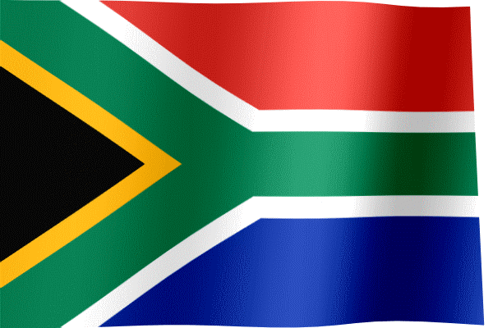
South Africa
By
Eoin Cunnane

Slide 2
South Africa Facts
There are 56.72 million people living in south Africa.
South Africa has 3 capital cities.
They are Cape Town , Blomfontein and Pretoria.
South Africa has 11 official languages , including Zulu, Afrikaans, Xhosa and English.
In 2010 South Africa hosted the FIFA world cup

Slide 3
South Africa Flag
This is the Republic of South Africa flag.
Black & White = The diverse people
Gold = Mineral wealth
Blue = Abundance of sunny skies
Green = Fertile land
Red = Hardships fought in struggle of apartheid
I like this flag.

Slide 4
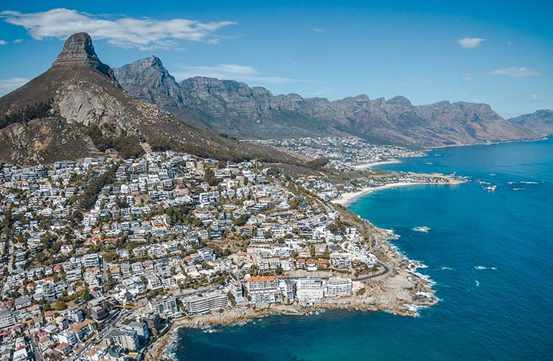
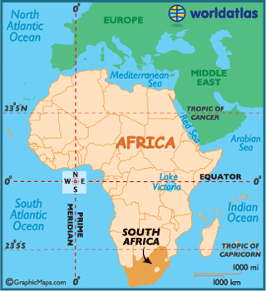
South Africa Geography
South Africa is on the southern tip of Africa
Its’ coastline stretches more than 2,850 kilometres (1,770 miles)

Slide 5
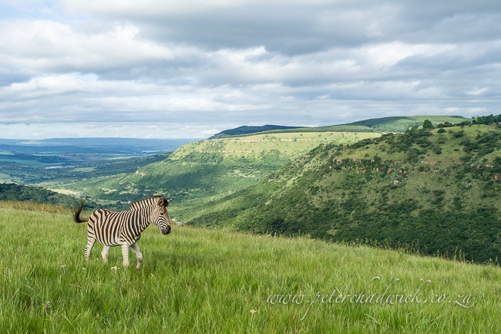
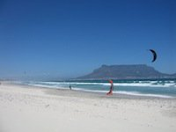
South Africa Geography
South Africa has various mountain ranges and the grasslands.
In the center of the country, has a high plateau.

Slide 6
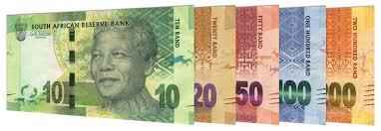
South Africa money
South Africa currency is the Rand.
Above is a few samples.

Slide 7
Nelson Mandela Born- 1918 Hometown – Mvezo, South Africa He was a civil rights leader He felt that everyone deserved to be treated the same no matter what skin colour and joined the ANC African national congress. He was arrested and spent 27 years in jail. In 1994 he became the first black President of South Africa and brought peace to the country after many years of struggle. Nelson Mandela died in December 2013 at the age of 95. His birthday, July 18th is known as Nelson Mandela day.

Slide 8
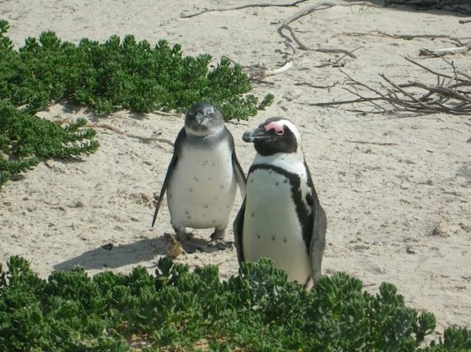
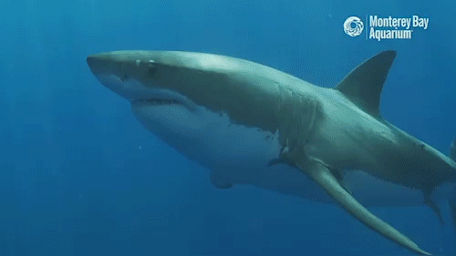
South Africa wildlife
South Africa has lots of wildlife.
There are many species of antelopes.
There are lions, elephants, giraffes, monkeys, great white sharks and even penguins!

Slide 9
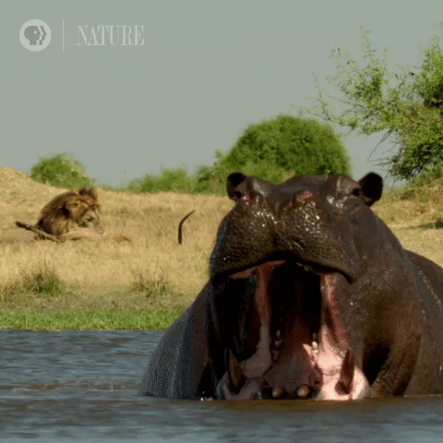
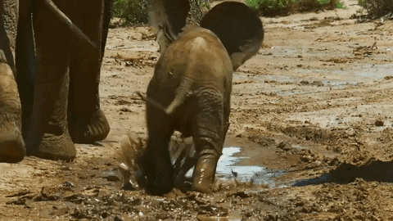
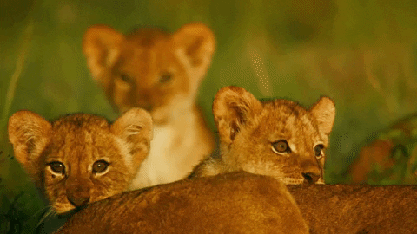
South Africa wildlife
Hippo
Elephant
Cub Lions

Slide 10
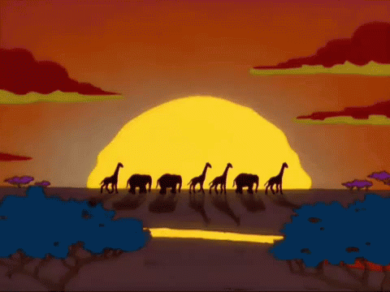
Thank you
For looking at this presentation

