Slide 1
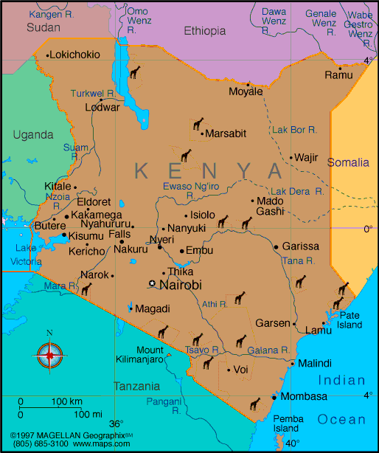
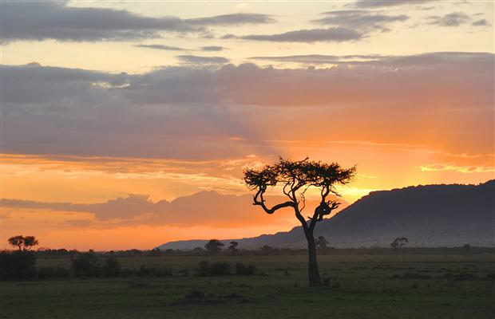
KENYA by Lily Hassett

Slide 2
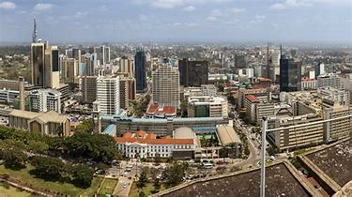
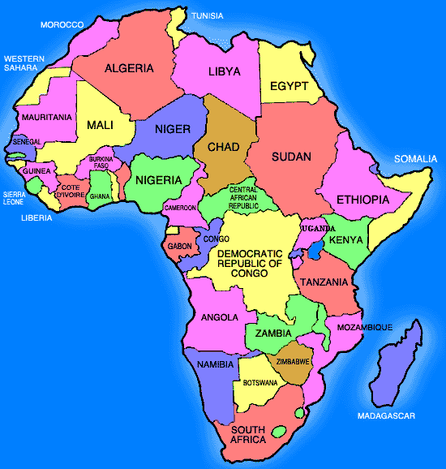
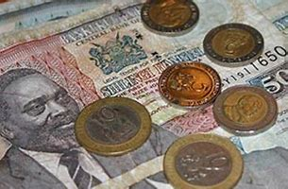
Facts
CONTINENT: Africa
CAPITAL: Nairobi
MAIN LANGUAGES: Kenyan and English
CURRENCY: Kenyan shillings
POPULATION: 48,397,527
SPACE: 224,081 square miles

Slide 3
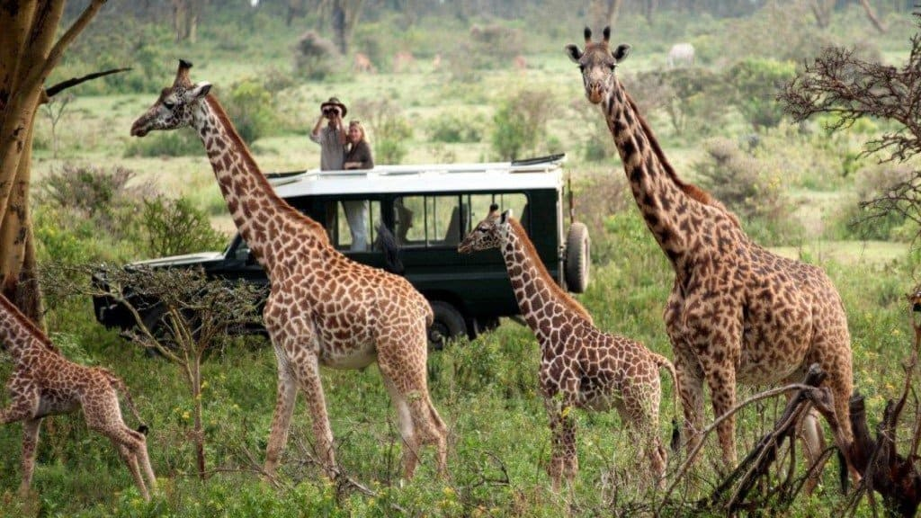
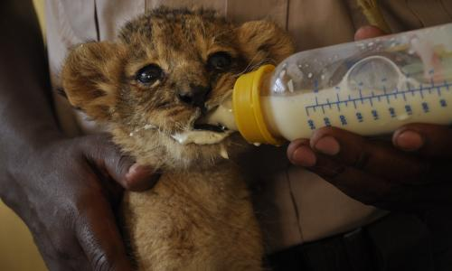
Wildlife
Kenya is really famous for it’s animals and landscape.
Millions of people visit Kenya every year to see its endless wild life and animals such as elephants lions cheetahs giraffes zebras hippos rhinos and more.
The Kenyan government have set up more than 50 reserves and parks to protect these animals.
Masi Mara Game Reserve
The Nairobi Animal Orphanage

Slide 4
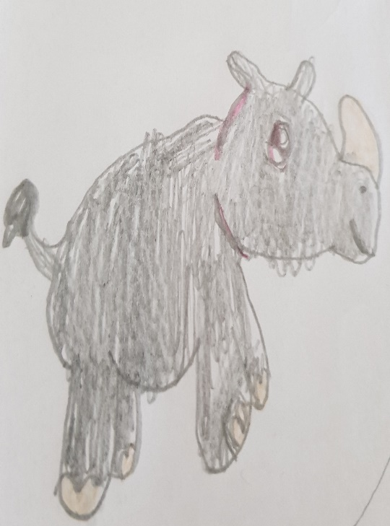
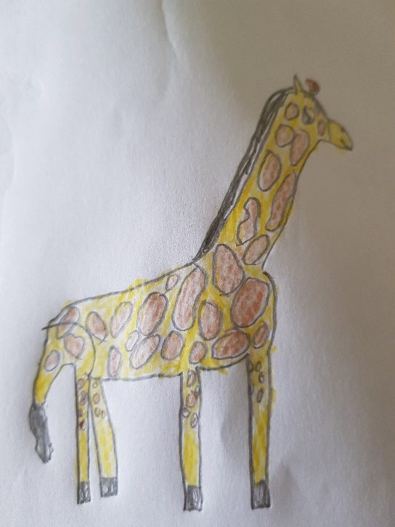
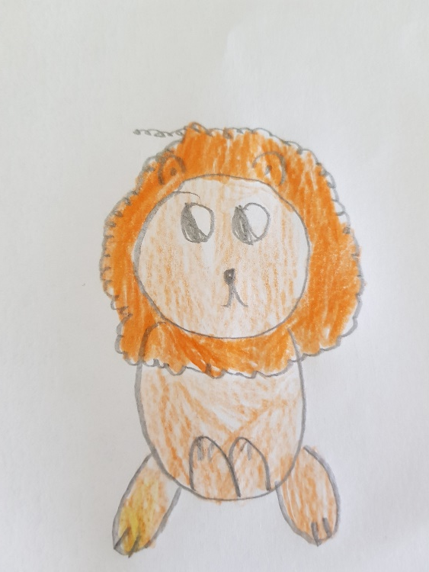
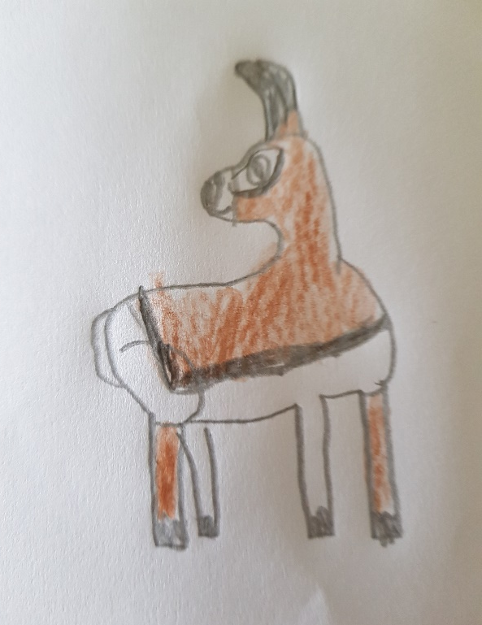
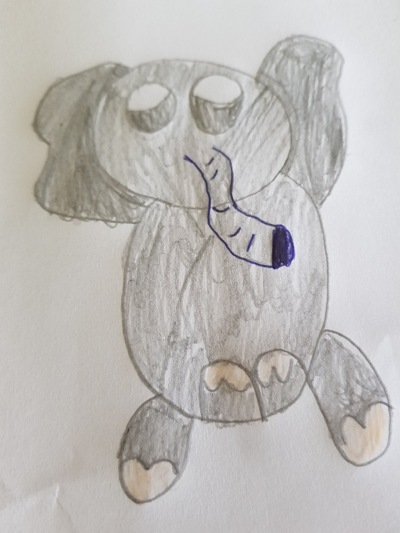
Animals
African Elephant:
hfakdjlajlk
NAME Giraffe.
TYPE Mammal
LIFE SPAN 25 years
POPULATION 80000
FACTS They only need 30 minutes to sleep. There is only 1 species
NAME Rhino
TYPE Mammal
LIFE SPAN 40to50 years
POPULATION 5200
FACTS Rhinos have been alive for more than 50 million years. Rhinoceros means nose horn.
NAME Lion
TYPE Mammal
LIFE SPAN 8to10 years
POPULATION 20000
FACTS A female lion is called a lioness. Lions are called the king of the beasts.
NAME Antelope
TYPE Mammal
LIFE SPAN 15to20 years
POPULATION No one has tried to count them
FACTS There are 91 antelope species
Unlike the giraffe. Their horns are made out off the same stuff are nails are made out off.
NAME Elephant.
TYPE Mammal
LIFE SPAN 60 to70 years
POPULATION 352271
FACTS An elephants trunk can grow up to 2 metres long. Elephants use their trunks as snorkels.

Slide 5
THANK YOU
For reading
Goodbye

