Slide 1
ethiopia
By james mchugh

Slide 2
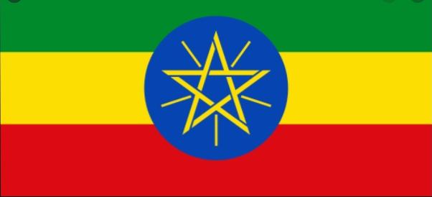
flag
the flag of ethiopia has three horizontal lines each of a different colour.
The top line is green and it represents the land.
The yellow in the centre sybolizes peace and hope.
The red represents strenght.

Slide 3
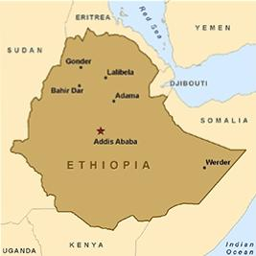
population and location
Ethiopia is located in east africa.
Ethiopia is one of the oldest countries in the world.
the population of ethiopia is 109,224,414.
The capital of ethiopia is addis ababa.

Slide 4
culture
One of ethiopias biggest festivals is timket. It is celebrated 3 days of every year to honor jesus christ baptism which took place on the river jordan.
New year in ethiopia begings on the 11th of september.
In ethiopia a year has 13 months.
Coffee is the biggest export product of ethiopia.

Slide 5
children
Children beteween the age of 7 and 12 years attend school.
Children living in bigger cities get an better educatoin by going to secondary school.
Primary school is from 7-12 ages and secondary is 12-18 years of age.

Slide 6
Thank you
By james mchugh

