Slide 1
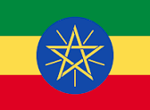
Ethiopia
By
Ella Kelly

Slide 2
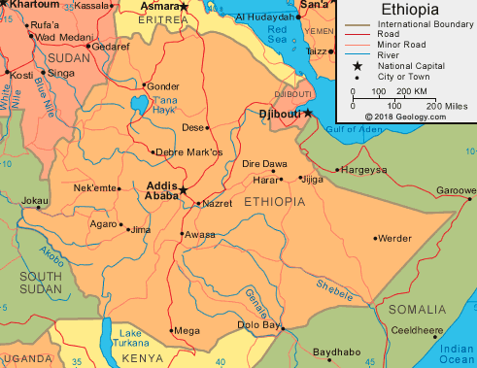
The currency of Ethiopia is the Birr.
The population of Ethiopia is 99 million people.
The capital of Ethiopia is Addis Ababa.
The total area of Ethiopia is 1,063,652 km²

Slide 3
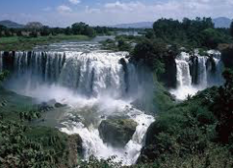
The language of Ethiopia is Amharic.
The main religions of Ethiopia are Orthodox Christian 43%, Muslim is 34% and Protestant is 19%.
The biggest river is the Blue Nile and the biggest lake is Lake Tana.

Slide 4
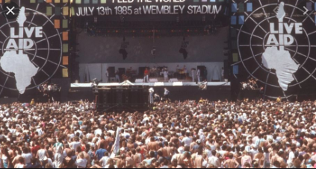
Ethiopia used to be called Abyssinia and is one of the oldest countries in the world.
Ethiopia are very famous for their long distance runners, the most famous being Haile Gebrselassie.
Many people know of Ethiopia due to the famine from 1983 to 1985 killing 1.2 million people. To help musicians lead by Irishman Bob Geldof raised millions of pounds through an event called Live Aid.

