Slide 1
Cote d’ivoire
In english it means ivory coast.

Slide 2
Fun facts
Coast of ivory has the worlds biggest church in yamoussoussoukro it is also the capital of ivory coast how cool is that?
Former chelsea footballer Didier Drogba is ivorycoast
Ivory coast is the worlds largest producer of cocoa ever .

Slide 3
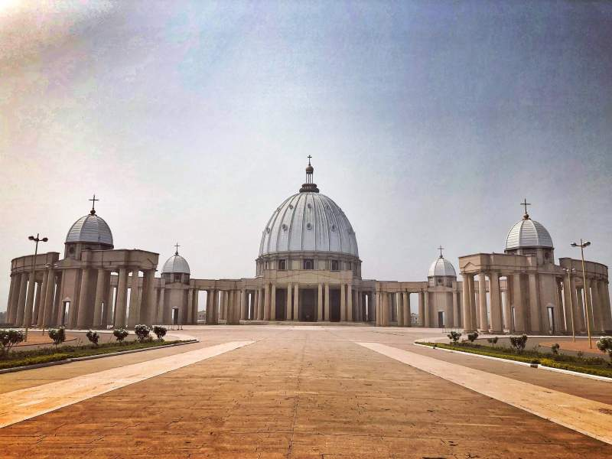
capital
Yamoussoukro is the capital of ivory coast.

Slide 4
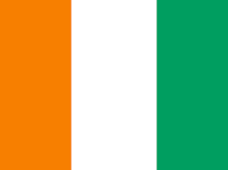
FLAG!!!!!!!!!!!!!!!!!!!!!!!!!!!!!!!!!!!!!!!!!!!!!
The flag is the same as the Irish flag backwords .COOL

